Slide 1


Clinica Santa Clarita, a leading center in Mexico for MSC stem cell clinical research and treatment
Welcome!

Slide 2
Moonshot
Add 10 BILLION years to the healthspan of our members!!!

Slide 3
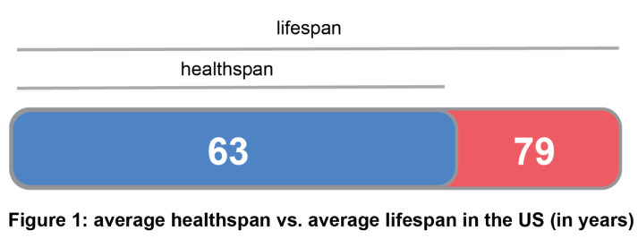

Healthspan versus Lifespan
“Healthspan” can be defined as the period of one’s life that one is healthy, being free from serious disease.
Ways to Improve Healthspan
Diet and Exercise
No Smoking / Moderate Drinking
Vitamins and Nutraceuticals
New Technology i.e Stem Cells
Institute for Public Health, 2017

Slide 4
Confidentiality Please
Project still under development – many details TBD.
Will go public Q1 2020

Slide 5
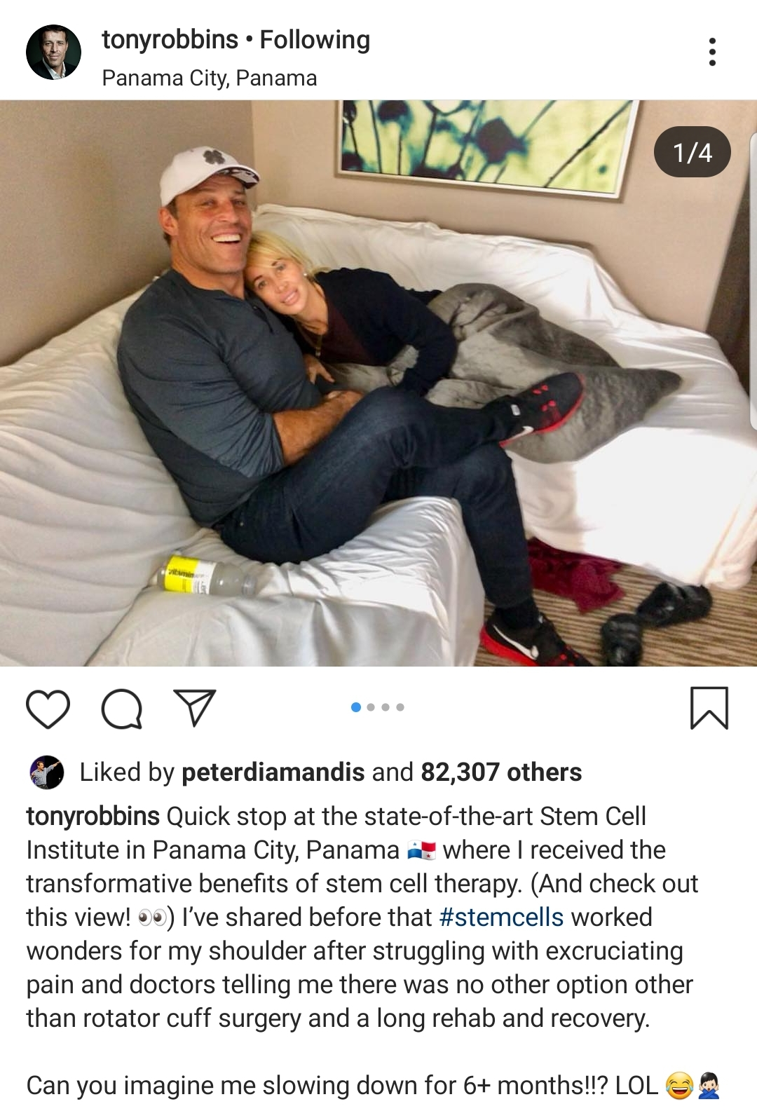
TONY ROBBINS
Entrepreneur and guide to millions including celebrities, presidents, and CEO´s around the world.
Started career by coaching people on how to become better versions of themselves
Made money and learned from the best on how to grow business and manage wealth
Now is focused on improving health

Slide 6
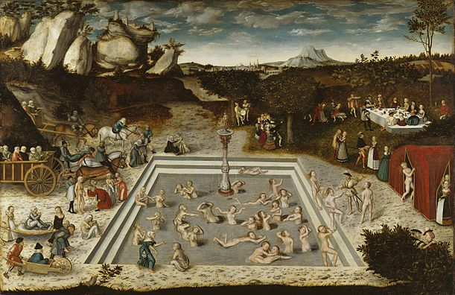
Fountain of Youth???
Aging as a disease
  Genes vs Environment
Many new anti aging drugs being developed
We need to be guided by someone we trust
Data Capture Is King

Slide 7

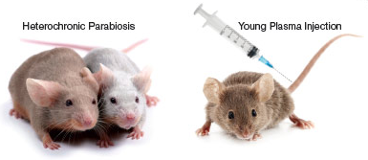


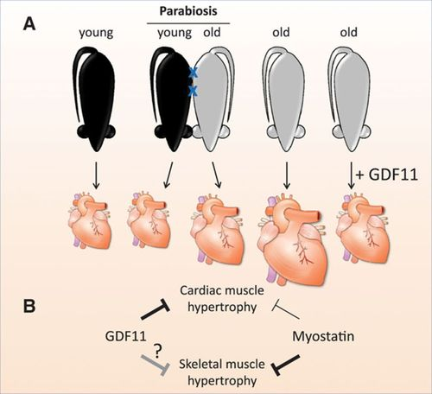
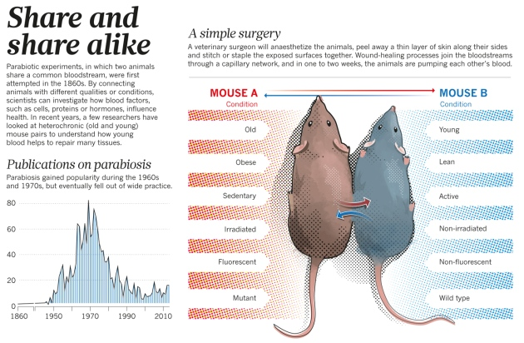
Study of Old mouse receiving Young blood:
  Improved muscle regeneration, importantly heart.
Notes:
There were 2 famous studies done separately by Harvard University and Stanford University. Based on previous studies done connecting blood circulation of an OLD mouse to a Young mouse and saw improvements in the old mouse. Harvard studied the old heart of a mouse, which looked big, thick and fibrotic and infused it with Young mouse blood. What happened? It normalized in size, thickness and functionality. The geniusus from Stanford did the same but for brain and saw improved circulation, reduced plaque and improvement in cognition in old mice. There must be something to it RIGHT!

Slide 8
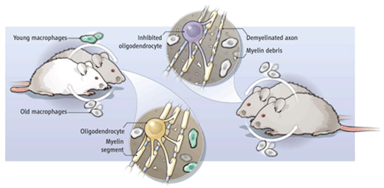
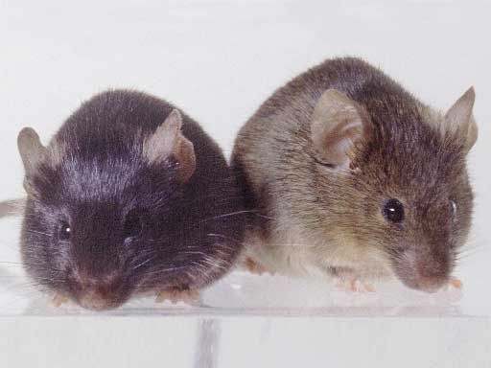
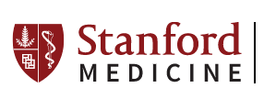
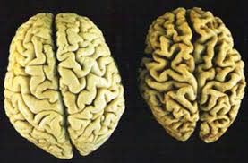
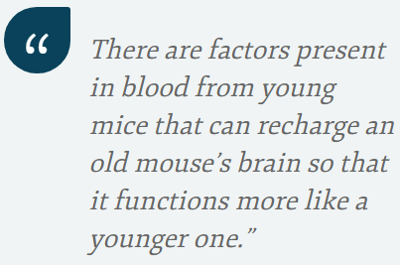

Slide 9
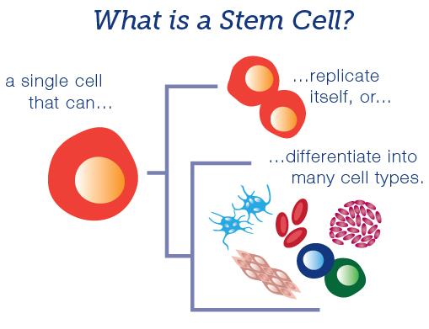
What are stem cells?
… Secrete growth factors and proteins to repair cells.
Notes:
Our body is composed by systems that are made from organs that are made of cells that are derived from stem cells. A single stem cell can either replicate into another stem cell or choose to become a cell from a specialized tissue such as heart, muscle, bone, brain, etc. And importantly, secrete exosomes that transport grwoth factors and protein tenplates to other cells for repair.

Slide 10
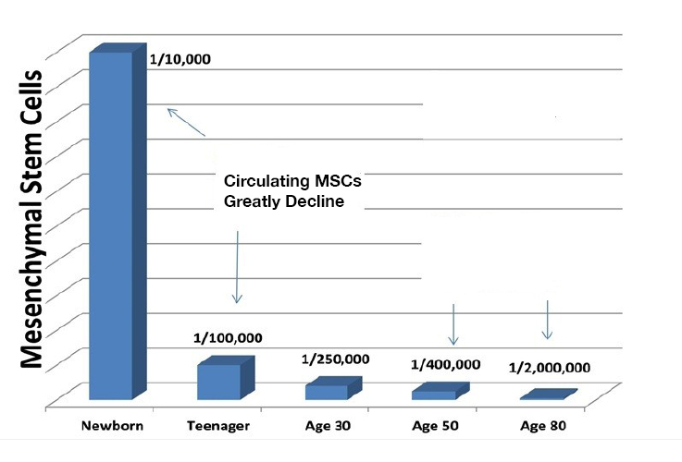
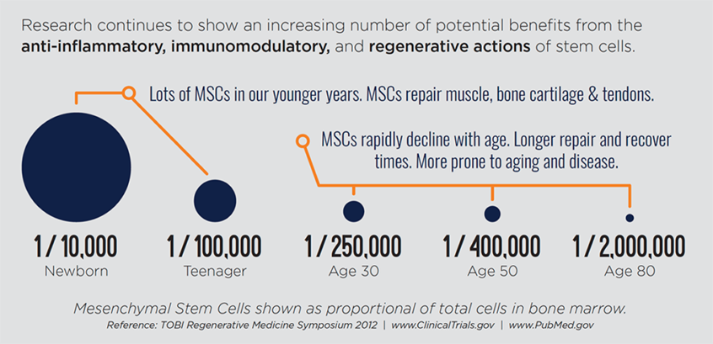
Stem cell decline since birth

Slide 11
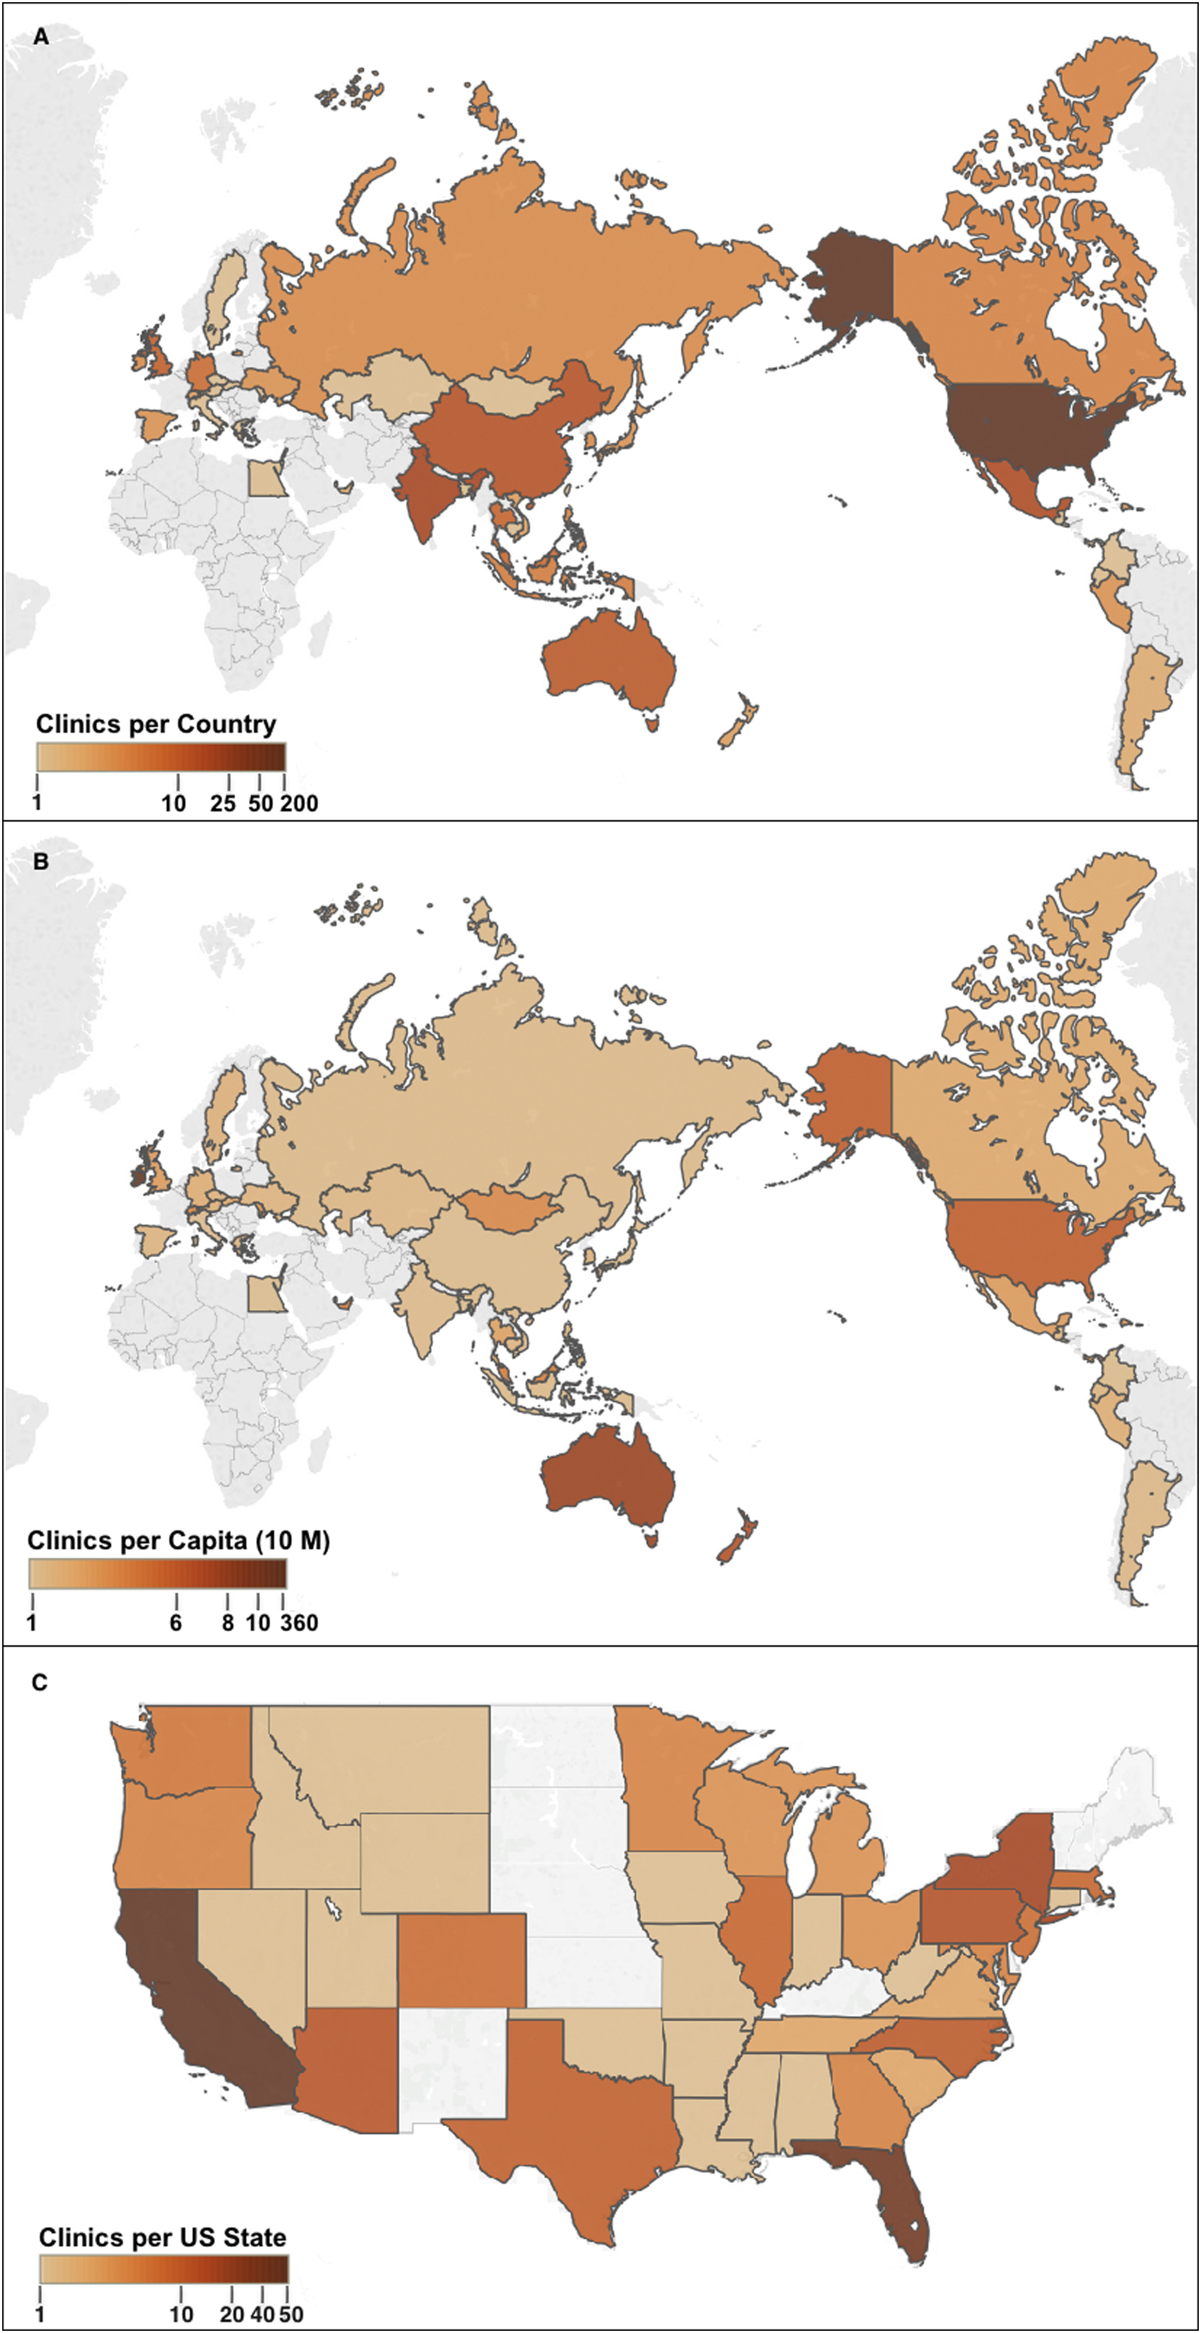
Stem cell clinics and treatments
There’s stem cell clinics all over the world, offering stem cell treatments for some conditions mentioned before.
The country with most stem cell clinics is the US.
California and Florida are the states that have more registered clinics.
They are unregulated by the FDA
What about Mexico?

Slide 12
Stem cell regulations in Mexico
Stem cell treatments are legal with the necessary licensing for cell bank, cell transplants and for regenerative medicine treatments.
Unfortunately, there are quack clinics and biologic products that are not well regulated by COFEPRIS (Mexican FDA), similar to the phenomenon occurring in the US.
Stem cell research is only opening up in this field, and it seems to be making progress.
It has been held up mostly because they are being considered the same as pharma, which most items do not apply.
We need to protect our patient’s health above all!!! (and their experience in Mexico)

Slide 13


Licences
Surgical License
Regenerative Medicine
Stem Cell Transplant
Stem Cell Bank
X - Rays
Blood Transfusion
Pharmacy

Slide 14
Mexican FDA Registered Clinical Trial Protocols
1. Knee Osteoarthritis
2. Chronic Musculoskeletal Pain
3. Spinal Cord Injury

